Slide 1

New Student Induction
February 2026

Slide 2
Overview
Who is who
Levels and Assessment
Timetable
Homework and study
Teacher and Student expectations
Attendance
Holidays
Facilities
In case of emergency

Slide 3
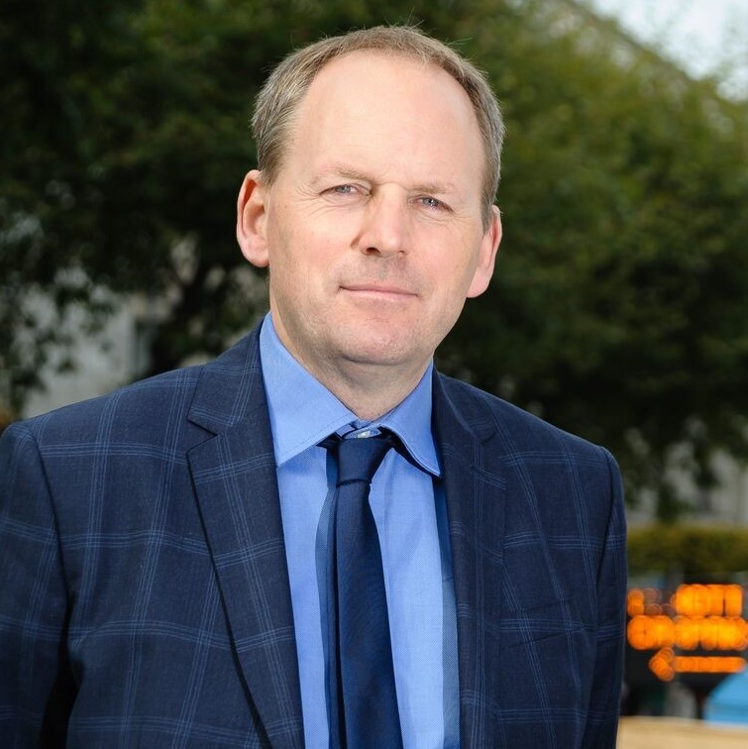
Who can help?
Jonathan Duignan
Academic Director
Bachelors Walk Reception
jonathan.duignan@dublinci.com
Academic questions
Learning tips
Social programme
Study options
CV writing
Higher Education options

Slide 4
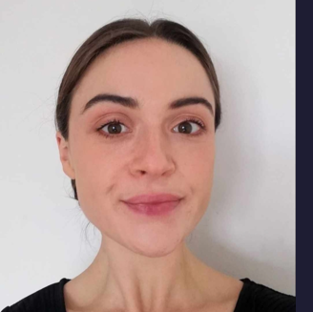
Who can help?
Sara Barrett
School Manager
Abbey Street office
sara. barrett@dublinci.com
Academic questions
Changing levels, class, End of Cycle assessments
Problems or questions about your class or teacher
Wellbeing & mental health support
Study / Higher Education options
Job application support (CVs, interviews)

Slide 5
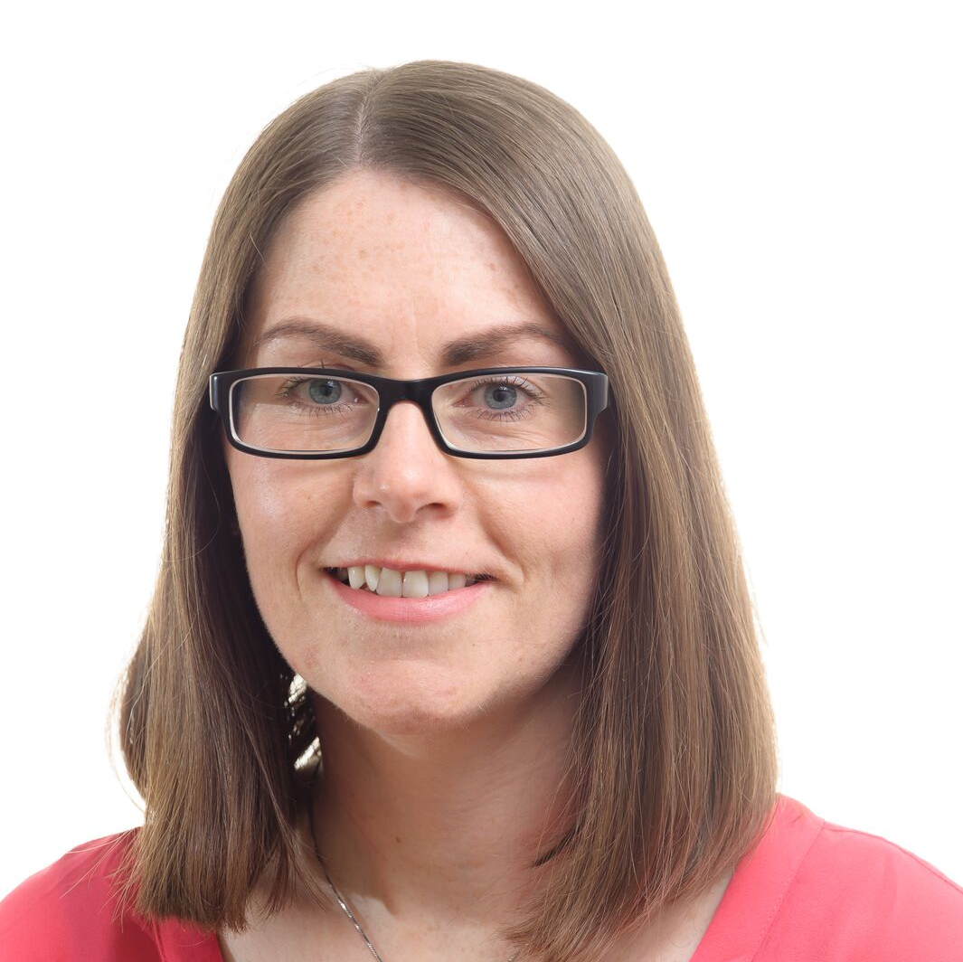
Who can help?
Siobhán Smith
Customer Service Manager
Bachelors Walk Reception
info@dublinci.com
Renewal
Bookings
Payments
Refunds
Accommodation
Medical insurance
Help with life in Dublin: seeing a doctor, looking for work, etc.

Slide 6
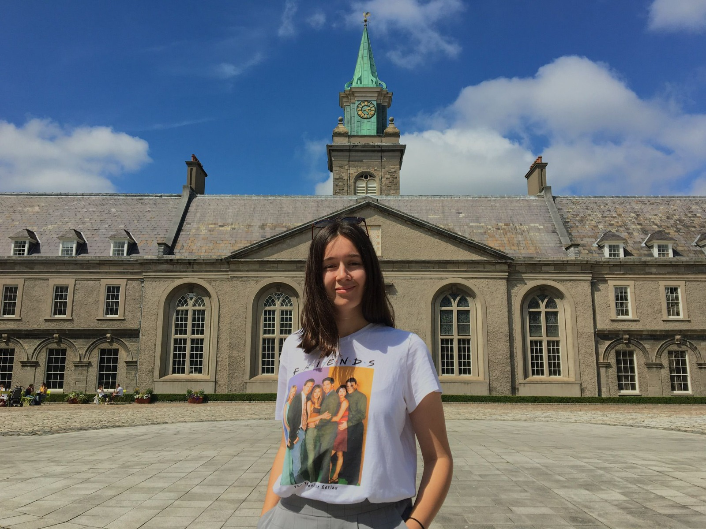
Who can help?
Carmen Teixeira
Academic Administrator
Bachelor's Walk Reception
carmen.teixeira@dublinci.com
Student Attendance
General Queries/ Assistance
Requesting holidays
Paperwork: Leap card, GNIB letters, bank letters, change address, etc.

Slide 7
Reception Services
If you require a letter for any of the below, please come and see Carmen in the Bachelor's Walk reception, or email reception@dublinci.com
Student Leap Card
GNIB letter
Medical Insurance (if you have enrolled via an agency, they are responsible for your medical insurance)
Please note that your address must be up to date

Slide 8
Course Options
Average Duration | Level | General/ Cambridge English | IELTS Preparation | English for Business Communications
- | Proficiency |  | C2 | C2
480 hours | Advanced | C1 | C1 | C1
240 hours | Upper Intermediate | B2 | B2
240 hours | Intermediate | B1
240 hours | Pre Intermediate | A2
240 hours | Elementary | A1
90 hours | Beginner | A0

Slide 9
Course Timetables
AM General English
Mon to Fri 9.00- 12.15
PM General English
Mon to Thu 13.00 to 17.00
AM IELTS:
Mon to Thu- 9.00 to 13.00
AM English for Business Communications:
Mon to Thu- 9.00 to 13.00
(Every class has two lessons and two teachers with 15-minute break)

Slide 10
Cycle 2
Week | Date | Assessment | Focus | Outcome
1 | February 16th
2 | February 23rd | Biweekly | Organization participation Homework | Feedback
3 | March 2nd
4 | March 9th | Biweekly | Organization participation Homework | Feedback
5 | March 16th
6 | March 23rd | End of Cycle | Reading Writing Speaking Listening | Up to date Assessment of your level
Notes:
DCI divides the year into 8 6-week cycles
Each cycle covers a half CEFR level and comprises 90 contact hours
Students are assessed three times in one cycle
After Week 2 and Week 4 of a cycle, students are formatively assessed
After six weeks students are summarily assessed using a full Cambridge style exam including speaking interview
Each students receives individual feedback from their teachers every two weeks

Slide 11
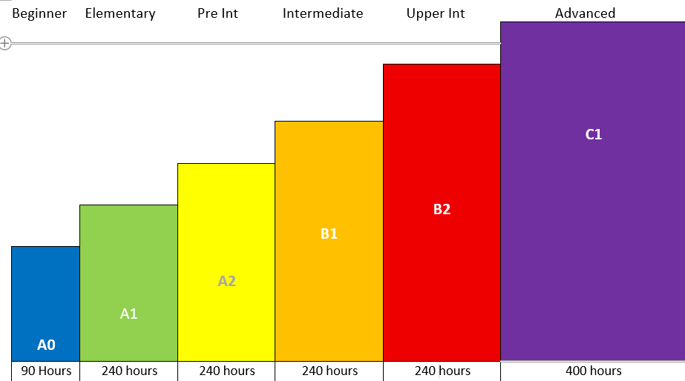
How long does it take to change level?

Slide 12
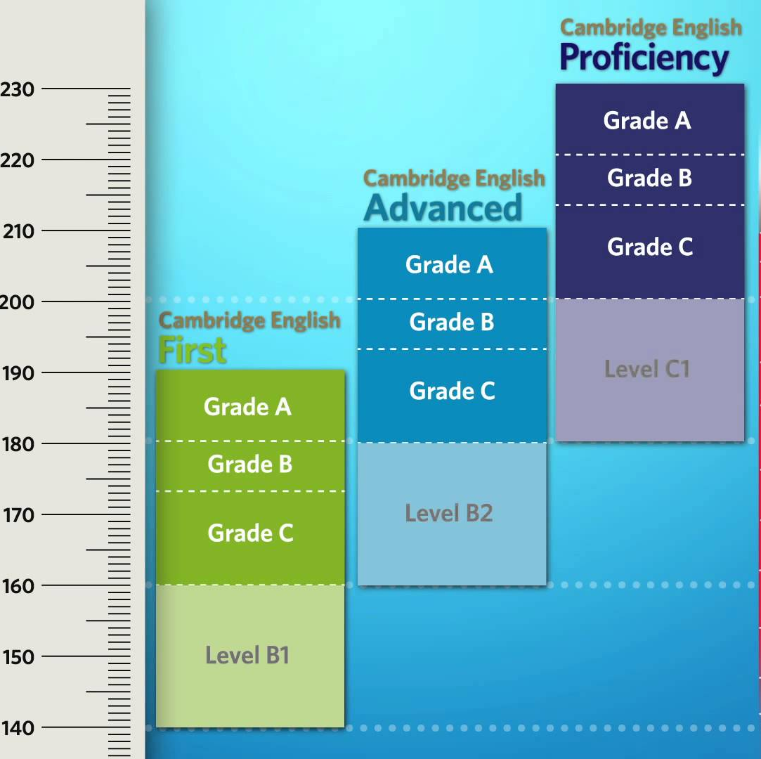
How do I change level?
Your initial level is determined by the Placement Test.
Every 6 weeks there is are End of Cycle Tests. This is an opportunity to prove you are ready for the next level.
The End of Cycle Result is determined by the total score across all papers (Writing, Reading, Listening, Speaking).
Please be sure if you are present for the End of Cycle Assessment, you will only get an opportunity every six weeks

Slide 13
Homework and Study
What can I do outside of class?
Keep a vocabulary notebook and continuously study it (8-10 words per day)
Keep a journal to practice your writing.
Read or listen to news / podcasts daily
DCI has a library of Graded Readers (physical and digital) that you can borrow.
Homework everyday
News & Podcasts
Students who revise outside of class progress faster.​
3-4 Hours Independent Study everyday

Slide 14
What can I expect from my teacher?
The DCI Learner Contract
Explain the plan for the cycle, week, day
Correct mistakes
Actively include everyone
Issue and correct homework
Give personalised feedback
Make every effort to get you to next level

Slide 15
What do my teacher and classmates expect from me?
The DCI Learner Contract
Attend class on time
Be respectful to other students, teachers and all staff
Speak English while in the school – even if your classmates are from the same country!
Concentrate on the lesson (phones in bags)
It's okay to make mistakes, you learn from them
Do not take photographs or recordings of people without explicit permission
Do the homework
Give honest feedback on the class when asked
Follow the Code of Conduct in the Student’s Handbook

Slide 16

Coursebooks
Keep your coursebook in good condition so it can be exchanged when you change level and you can get your deposit back when you finish your course.
Do not write in your book.
If you write in your coursebook, you should use pencil and you must completely erase all marks before exchanging it.
If you receive a coursebook that is not in good condition, please go to the Reception and let us know.

Slide 17
Punctuality
Please arrive before class (re)starts
9.00am
10.45am
1.00pm
3.15pm
Please do not leave class until it ended
10.30am
12.15pm
1.00pm
3.00pm
5.00pm
Latecomers will refused entry

Slide 18

Attendance
We expect 100% attendance.
If you need to check your attendance record please email reception@dublinci.com
a minimum 85% attendance is an INIS requirement to work and study in Ireland.
There are two classes per day. Attendance is counted for each session – i.e., if you miss the first class, you can still get attendance for the second class (50% for that day).

Slide 19

Attendance
Attendance is a record of fact – you are in class or you are not.
Attendance is checked daily by teachers, and admin staff
If you need to take personal time, holiday can be used (approval is needed first)
Job interviews, GNIB appointments, training courses, etc, do not justify absence.

Slide 20
Attendance Warnings
If you miss more than 20% of your classes in any two-week period, you will receive an attendance warning.
If your attendance continues to be poor after three warnings, your course will be terminated.
If you miss 10 consecutive days of class after a warning without communicating with the school, your course will be terminated with or without passing three warnings.
Mon | Tue | Wed | Thu | Fri
Mon | Tue | Wed | Thu | Fri
80%
First Warning!

Slide 21
Holidays
Immigration permission and course at DCI includes:
-25 weeks of study
-8 weeks of holidays
“Holidays” means you do not lose attendance for missing class.
By default, these holidays are at the end of your course. 3 weeks of holidays are also used for the Christmas break (15th Dec to 2nd Jan).
If you have an emergency and need to use holiday time outside of this, you must request this change in writing to reception@dublinci.com in advance.
When you need to use holidays during your course time for emergencies, one week of holiday is available for every three weeks of course you have completed (holiday time = 33% completed course time)
Immigration requires you to keep 3 weeks at the end of your course (you cannot use all your holidays before you finish your course).

Slide 22
End of Course exam
You must complete an external exam at the end of your course.
DCI will make an appointment for you to take the TIE exam. You will have one week to confirm your appointment or request a transfer to a different exam (Cambridge, IELTS, TIE, LanguageCert…)
It is a compulsory part of your permission to work and study in Ireland.

Slide 23
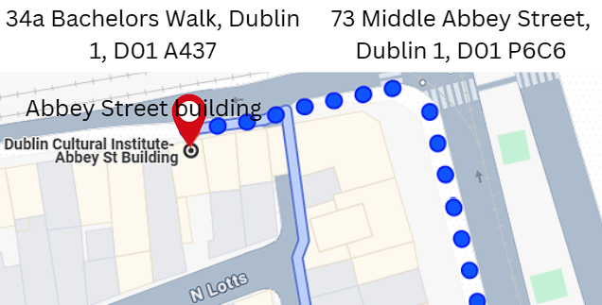
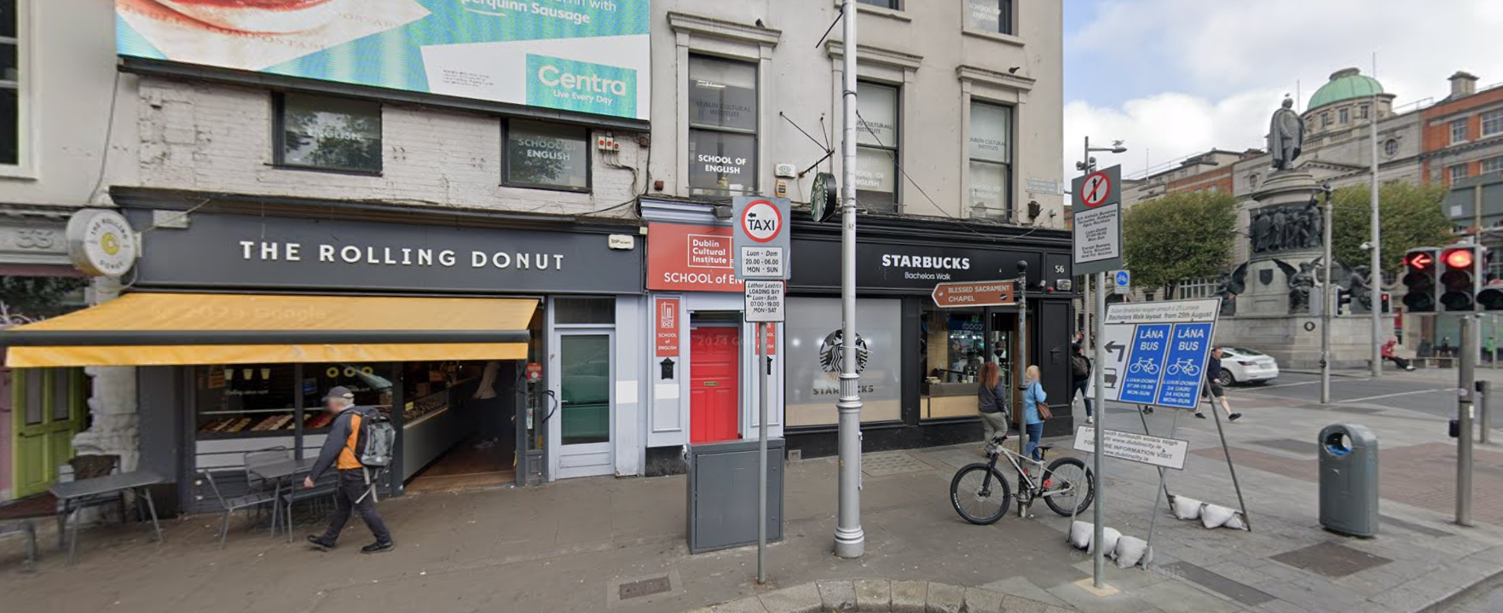
34a Bachelors Walk D1

Slide 24
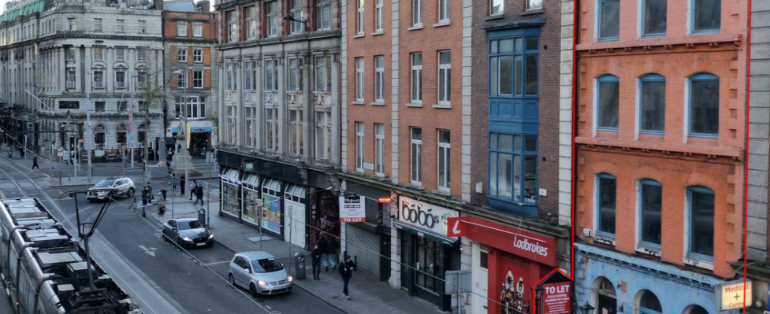
73 Middle Abbey Street D1

Slide 25

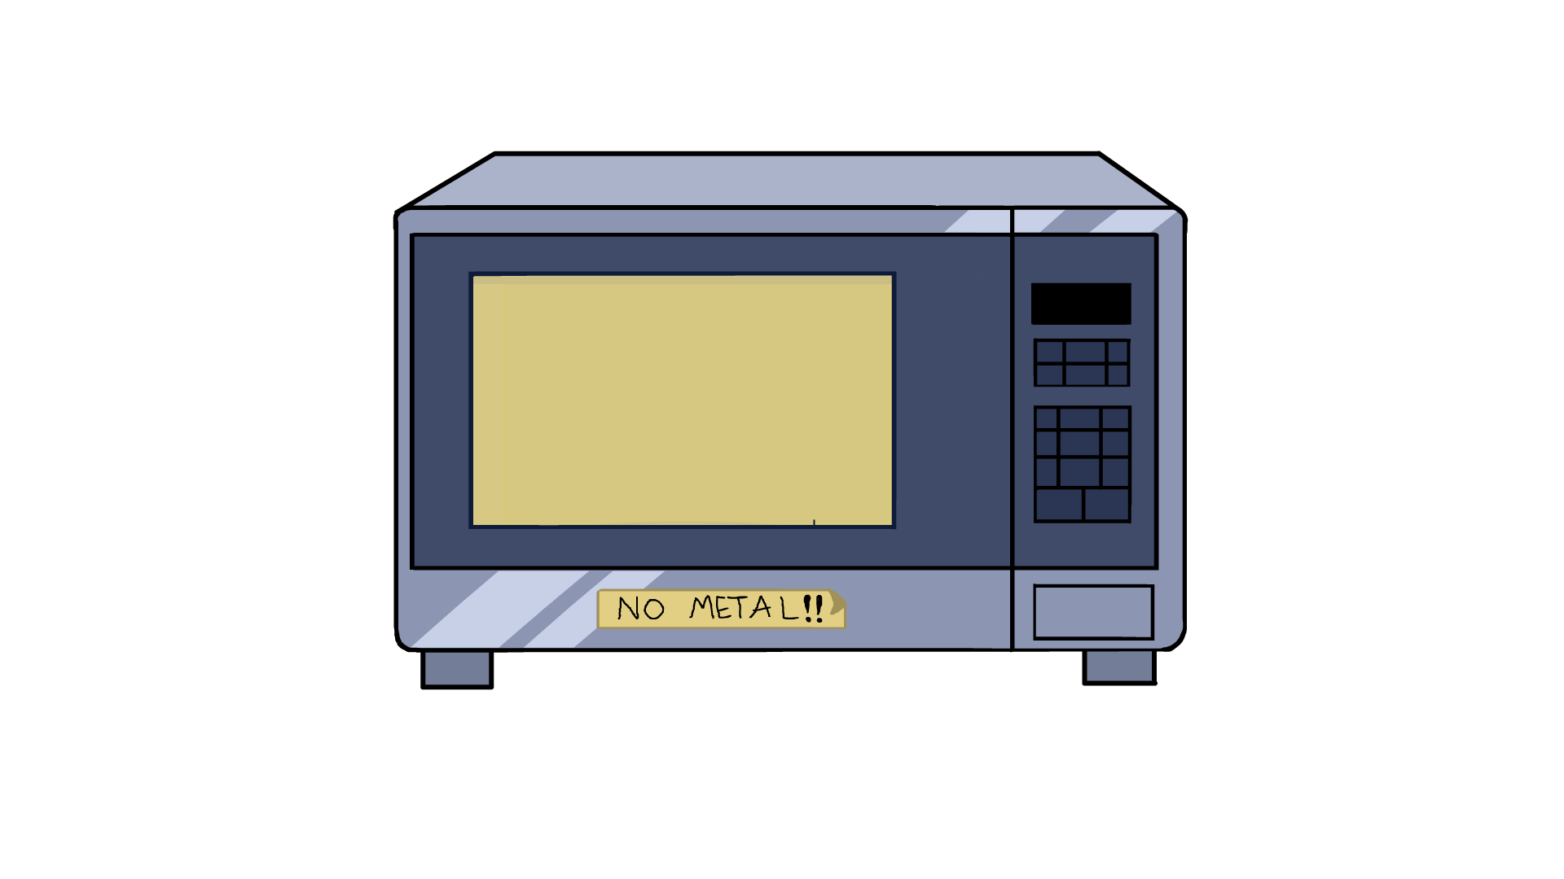

Facilities
There are two buildings:
34A Bachelors Walk and 73 Middle Abbey Street.
In both the Bachelors Walk and Abbey Street buildings,
there is a Student Lounge on the top floor.
In the Student Lounges, you can find:
-A kettle for hot water
-Drinking water
-Microwaves
We do not supply cutlery, cups or glasses – you should bring your own keep cup or water bottle. Please keep lids on any tea/coffee cups.

Slide 26





Care of the facilities
Please wipe your feet on your way into the school.
Do not eat meals in the classroom. You can eat in the canteen or student lounges.
Please keep lids on drinks.
There is no space for scooters or bicycles inside the school.
Toilets are not bins. Do not put garbage in the toilets – only toilet paper and human waste.
Do not put rubbish or toilet paper in the menstrual product bins.

Slide 27

Emergency procedure
Please sign in every day at Reception when you enter the school.
Follow your teacher's instructions.
Exit the classroom calmly.
Leave your belongings where they are.
Exit the school and assemble with your teacher, away from the door.
Wait until you have been checked and told to enter by a manager.

